Slide 1
DevSecOps
Value stream and maturity analysis
25 April 2019

Slide 2
Agenda
Introduction video (30 min)
Value Stream Introduction (10 min)
Value stream Mapping (30 min)
Maturity Assessment: CM (15 min)
Maturity Assessment: EST (15 min)

Slide 3
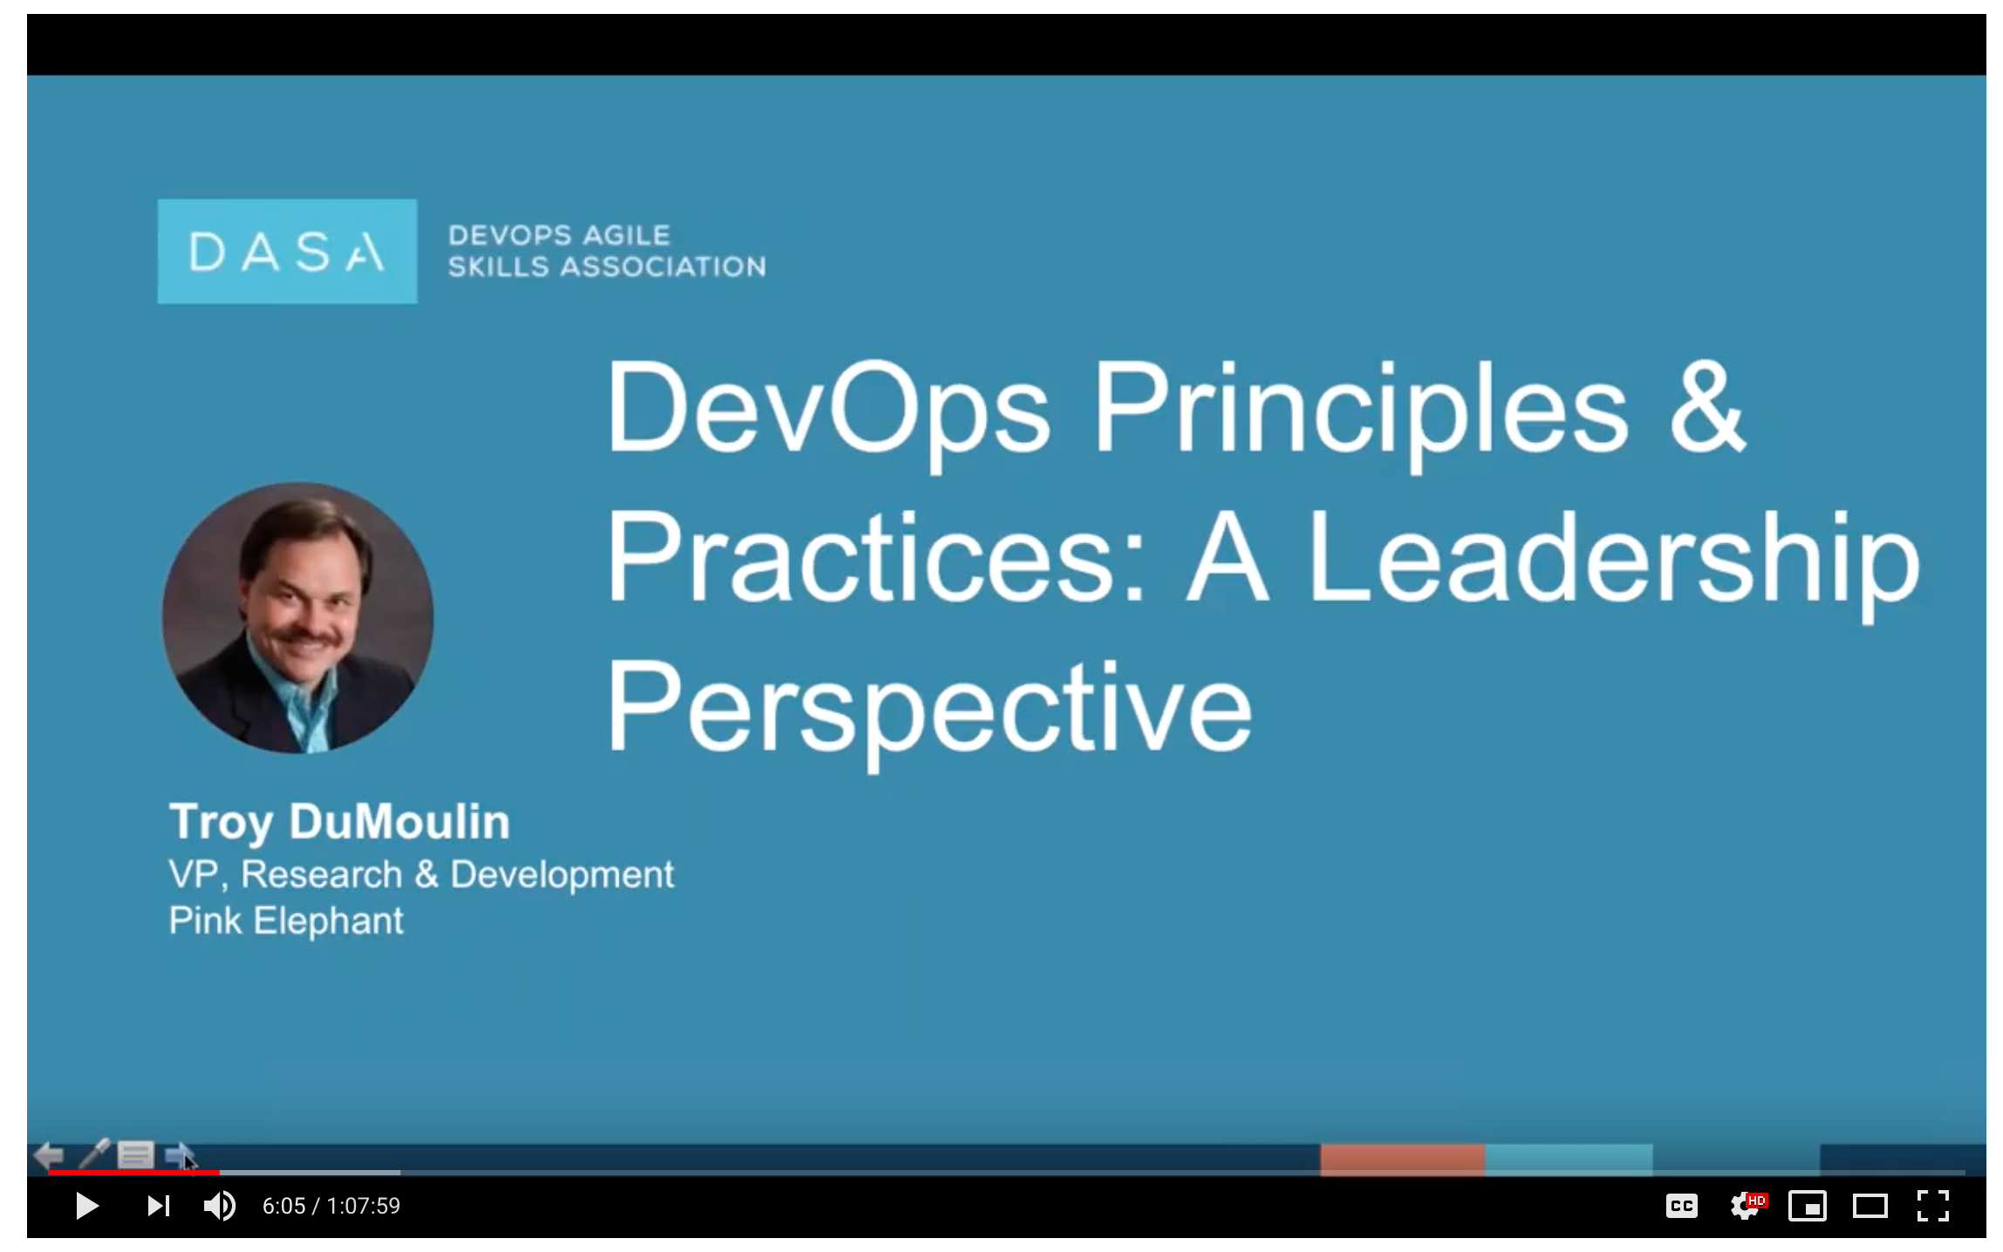
Introduction Video

Slide 4
Value Stream Introduction

Slide 5
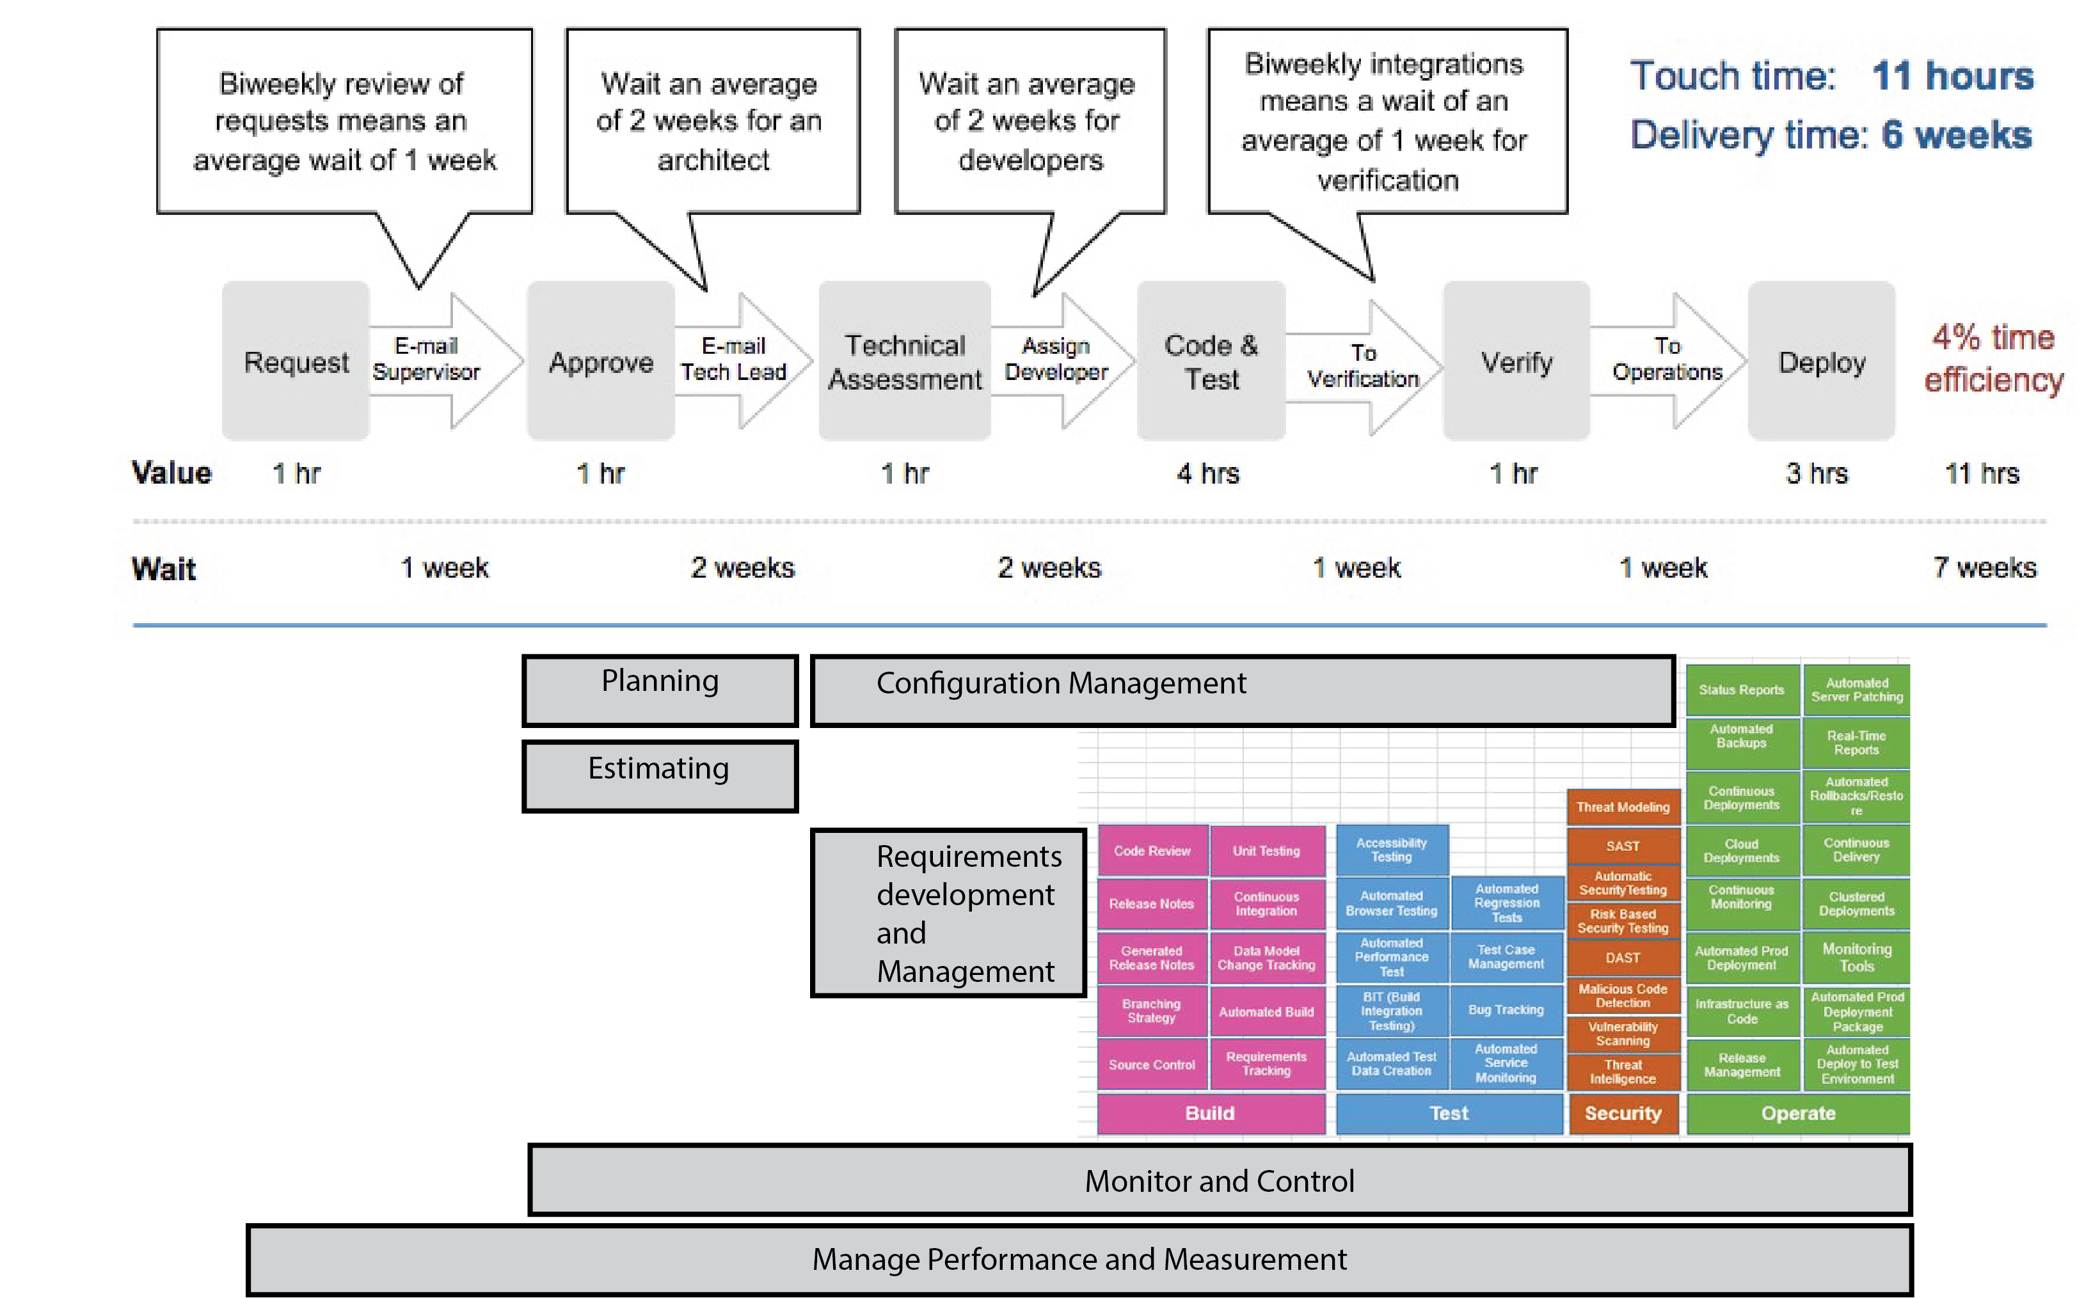
Maturity Assessment

